Slide 1
Developer Tools

Slide 2
Topics Covered
Working with NUnit and NCover
What is Unit Testing
Advantages of Unit Testing
NUnit Testing Framework
Microsoft Test Framework
Code Coverage with NCover and Visual Studio
Visual Studio Code Analysis
Using FxCOP, StyleCOP & Log4Net
Overview of FxCOP
Overview of StyleCOP
Working with Log4Net

Slide 3
Unit Testing
Level of Software Testing in which every unit/component is tested and validated.
First level of testing.
Fixes bugs early in the development life cycle of the project.
Can be done Manually or it can be Automated.
Notes:
A unit is the smallest testable part of a software.
It usually has one or more inputs and usually a single output.
It is performed using the white box testing method.
It is normally performed by software developers themselves or their peers. It can also be done by individual testers in few scenarios.
Unit testing is commonly automated but may still be performed manually.
A manual approach to unit testing may employ a step-by-step instructional document.
The workflow of Unit Testing is
Create Test Cases
Review/Rework
Baseline
Execute Test Cases.

Slide 4
The output of the requirement analysis and the requirement specification is used as the input for writing ____________
a) User Acceptance Test Cases b) User Rejection Test Cases c) Product Rejection Test Cases d) Product Acceptance Test Cases

Slide 5
The output of the requirement analysis and the requirement specification is used as the input for writing ____________
a) User Acceptance Test Cases b) User Rejection Test Cases c) Product Rejection Test Cases d) Product Acceptance Test Cases

Slide 6
Benefits of Unit Testing
Codes are more Modular and Reusable.
Cost of fixing a defect is lesser.
Debugging is easy.
Codes are more Reliable.
Notes:
In order to perform Unit testing codes have to be modular. This means that they are reusable.
The cost of fixing a defect detected during unit testing is lesser in comparison to that of defects detected at higher levels. Compare the cost (time, effort, destruction, humiliation) of a defect detected during acceptance testing and when the software is live.
Debugging is easy. When a test fails, only the latest changes need to be debugged. With testing at higher levels, changes made over the span of several days/weeks/months need to be scanned.
When every piece of code has been test, the code becomes reliable.

Slide 7
NUnit Testing Framework
NUnit is a unit testing framework for .NET. It is the most used framework for writing unit test cases.
Nunit is not an automated GUI testing tool.
The test scripts are written in C# or VB.NET and Nunit allows its tools and classes to make unit testing easier.
NUnit works by providing a class framework and a test runner application
Notes:
NUnit is Open Source software and NUnit 3.0 is released under the MIT license. This framework is very easy to work with and has user friendly attributes for working.
It is preferred to write the test codes in different assemblies called Test Assemblies. We need to run these test assemblies to check whether all test cases are passed or failed. TestRunner can be used for this purpose.
Test Runners are UI tool which actually run NUnit test cases and show the result of test cases whether they are passed or failed.
NUnit only provides some custom attributes and some static Assert classes. With the combination of custom attributes and static classes, we can write unit test cases easily.
Some of the custom attributes are:
TestFixture
Setup
TearDown
Test
Category
Ignore
TestCase
Repeat
MaxTime

Slide 8
[Ignore] attribute is used for the code that needs to be____________?
a) Commented
b) Bypassed
c) Asserted
d) Tested

Slide 9
[Ignore] attribute is used for the code that needs to be____________?
a) Commented
b) Bypassed
c) Asserted
d) Tested

Slide 10
Microsoft Test Framework
Visual Studio can be used to define and run unit tests to maintain the code health and code coverage.
The live results of the unit test can also be seen using the Microsoft Test Framework or Nunit testing Framework.
Unit Testing can also be implemented using third party test frameworks such as Boost, Google and Nunit.
Nuget Package Manager can be used to install the third party testing frameworks.
Notes:
The project to be tested can be opened in VS and to the same solution we can add another new project which is a unit test project template.
We can refer our project in the testing project and write a TestClass with various TestMethods which will check the validity of the classes and methods of our project.
The Test cases can be tested by opening the Test Explorer and clicking Run All.
If the test results in Success, it will be depicted with a green color tick mark
If the test results in Failure, a red color Wrong indicator is shown against the tests.

Slide 11
Which doesn’t belong to assert class
a) isInstanceOfType
b) areEqual
c) throwsException
d) Isnothing

Slide 12
Which doesn’t belong to assert class
a) isInstanceOfType
b) areEqual
c) throwsException
d) Isnothing

Slide 13
Code Coverage
Code Coverage is a measure which describes the degree to which the source code of the program has been tested.
Shares a quantitative measurement and the defines the degree to which the source
Notes:
Code coverage can be used by large and small teams who are using a range of development tools and processes to help improve code quality, customer satisfaction, revenue, productivity, and communication while also helping to reduce costs and risks or is a measurement of how many lines/blocks/arcs of your code are executed while the automated tests are running.

Slide 14
Visual studio Code Analysis
Visual Studio can perform code analysis of managed code in two ways
Legacy analysis, also known as FxCop is a static analysis of managed assemblies
Code analyzers, a .NET Compiler Platform ("Roslyn") analyzers to analyze your code for style, quality and maintainability, design, and other issues.
Notes:
Note that Code Analysis is only available In the Premium and Ultimate editions of Visual Studio 2010 and also Visual Studio 2005 & 2008 Team System.
Legacy analysis (static code analysis) is not supported for .NET Core and .NET Standard projects in Visual Studio. If you run code analysis on a .NET Core or .NET Standard project as part of msbuild, you'll see an error similar to error : CA0055 : Could not identify platform for <your.dll>. To analyze code in .NET Core or .NET Standard projects, use code analyzers instead.

Slide 15
Overview of FxCop
It is a tool that performs static code analysis of .NET code.
It provides hundreds of pre defined rules that perform various types of analysis such as Interoperability, Maintainability, Mobility, Naming, Performance, Portability, globalisation, Reliability, Security, and Usage.
It also supports to create custom rules
Notes:
However,
It cannot automatically fix errors if it finds.
Currently supports only one type of report. No support for custom type report.
FxCop provides a tool to help developers to follow their company's coding standards. FxCop does code analysis to check whether the new code is compliant with the coding standards and naming conventions followed by the company. FxCop will ensure that the specified rules are used in the source code.
FxCop includes both GUI and command line versions of the tool.
It works by analyzing object code, as opposed to other tools that simply look at source code.

Slide 16
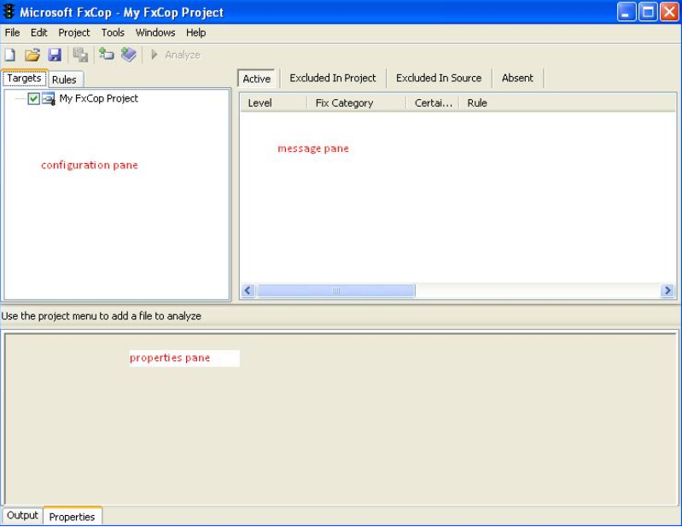
To start with FxCop, Go to Start Menu -> All Programs -> "Microsoft FxCop" option and then click on FxCop.
It contains 3 panes – configuration pane, message pane and properties pane.
Notes:
Configuration Pane
Used to set up target files and rule sets
You can also group the rules into categories after setting them up
Message Pane
Clicking on the Analyze button in the toolbar fills the message pane with all the messages it found.
Selecting a message shows you a summary in the properties pane. It includes the target item which caused the message, a short resolution description and also a help link which shows you a detailed description of the issue and the resolution for it.
Properties Pane
This pane has two tabs. The properties tab & the Output tab.
Properties tab shows information about the selected assembly, namespace, type, type member, group of rules, rule or message.
The Output tab shows informational, warning and error messages generated by the rules. These messages only appear if the TraceGeneral trace-switch in the FxCop.exe .config file is enabled.

Slide 17
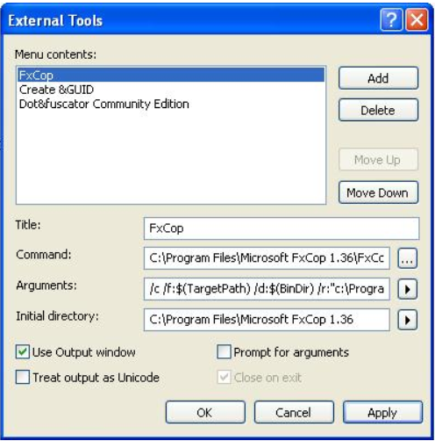
To set up FxCop as an external tool in Visual Studio:
On the Tools menu, click External Tools, and then click Add.
Enter the following information in External Tools dialog box:
Title, Command, Arguments, Initial directory.
Notes:
If you had created custom rules and want to apply to all projects, place the custom rule DLL to c:\Program Files\Microsoft FxCop 1.36\Rules.

Slide 18
FX COP can be run as
a) Command line
b) Windows application
c) Both
d) None of the above

Slide 19
FX COP can be run as
a) Command line
b) Windows application
c) Both
d) None of the above

Slide 20
Overview of StyleCOP
StyleCop analyzes C# source code to enforce a set of style and consistency rules. It can be run from inside of Visual Studio or integrated into an MSBuild project.
The ultimate goal of StyleCop is to allow to produce elegant, consistent code that team members and others who view developer code will find highly readable.
Developers can implement their own rules if they so choose.
Notes:
Currently it runs only on C#.
The rules are classified into the following categories:
Documentation
Layout
Maintainability
Naming
Ordering
Readability
Spacing

Slide 21
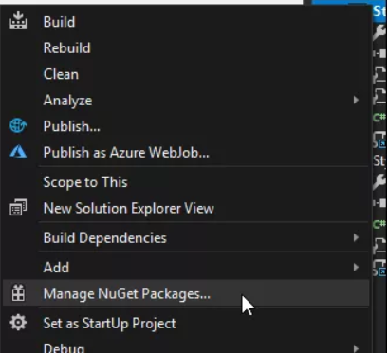
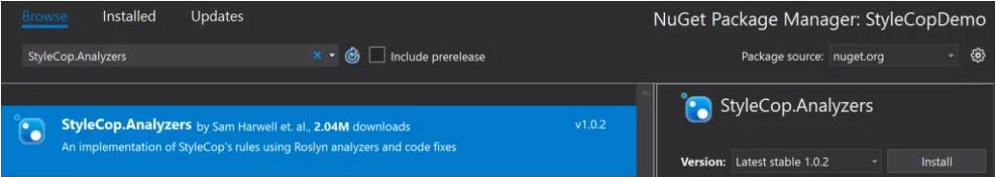
Installing StyleCop
To add StyleCop to your project, right-click your project in Visual Studio’s Solution Explorer, and choose “Manage NuGet Packages…”:
Search for “StyleCop.Analyzers” and install the latest stable version
build your project in Visual Studio and chances are, you will see several warnings in the output window
Notes:
Using StyleCop.Analyzers
The preferable way to use the analyzers is to add the nuget package StyleCop.Analyzers to the project where you want to enforce StyleCop rules.
The severity of individual rules may be configured using rule set files in Visual Studio 2015 or newer. Settings.StyleCop is not supported, but a stylecop.json file may be used to customize the behavior of certain rules. See Configuration.md for more information.

Slide 22
Configuring StyleCop
Configuring StyleCop is done in two optional steps.
First, you can use rule set files to configure which rules are checked and how strongly you feel about them.
Second, you can add a stylecop.json file to your project to fine-tune some rules.

Slide 23
Which is not an action of rulesets in Stylecop
a) Warning
b) Bug
c) Info
d) Hidden

Slide 24
Which is not an action of rulesets in Stylecop
a) Warning
b) Bug
c) Info
d) Hidden

Slide 25
Working with Log4Net
It allows the developer to control which log statements are output with arbitrary granularity. It is fully configurable at runtime using external configuration files.
You can write your .NET logs to a file on disk, a database, a log management system or potentially dozens of other places, all without changing your code.
Notes:
Log4net has three main components: loggers, appenders and layouts. These three types of components work together to enable developers to log messages according to message type and level, and to control at runtime how these messages are formatted and where they are reported.
Loggers are named entities and are case-sensitive
Appenders are how you direct where you want your logs sent. The most popular of the standard appenders are most likely the RollingFileAppender and ConsoleAppender.
The Layout is responsible for formatting the logging request according to the user's wishes, whereas an appender takes care of sending the formatted output to its destination.

Slide 26
The Configuration
The standard way to set up a log4net logger is to utilize either the app.config file in a desktop application or the web.config file in a web application.
There are a few pieces of information that need to be placed in the config file in order to make it work properly with log4net.
Notes:
In a config file where there will (potentially) be more information stored beyond just the log4net configuration information, you will need to specify a section to identify where the log4net configuration is housed. Here is a sample section that specifies that the configuration information will be stored under the XML tag "log4net":
Hide Copy Code
<configSections> <section name="log4net" type="log4net.Config.Log4NetConfigurationSectionHandler, log4net"/> </configSections>

Slide 27
Which Log4net appender is used to write logging events to the .NET system?
a) log4net.Appender.ConsoleAppender
b) log4net.Appender.EventLogAppender
c) log4net.Appender.DebugAppender
d) log4net.Appender.LocalSyslogAppender

Slide 28
Which Log4net appender is used to write logging events to the .NET system?
a) log4net.Appender.ConsoleAppender
b) log4net.Appender.EventLogAppender
c) log4net.Appender.DebugAppender
d) log4net.Appender.LocalSyslogAppender

Slide 29
Which tool analysis compiled code
a) Fx Cop
b) Style Cop
c) Log4net
d) None of the above

Slide 30
Which tool analysis complied code
a) Fx Cop
b) Style Cop
c) Log4net
d) None of the above

